Slide 1
TOP 5 LENDING TRENDS
TO WATCH IN 2019

Slide 2
Agenda
State of Auto Finance Lending
What Are Customers Asking For?
Top 5 Trends to Watch in Auto Finance Lending
Key Takeaways
About PayNearMe
Q&A
PAYNEARME UPDATE
2

Slide 3
State of Auto Finance Lending
After years of growth, auto sales have been declining since 2017. The decline is predicted to continue through 2018 and possibly into 2019.
Source: U.S. Car Sales Will Slip A Bit In 2018, Forbes
PAYNEARME UPDATE
3

Slide 4
State of Auto Finance Lending
Owners are keeping their cars longer
Used car inventory is high which reduces demand for new cars
City-dwellers often prefer car-sharing or Uber/Lyft to owning cars outright
Rising interest rates make consumers wary of taking on new debt
Declining sales means fewer auto loans, greater competition among lenders, and the need to optimize loan portfolio profitability
PAYNEARME UPDATE
4

Slide 5
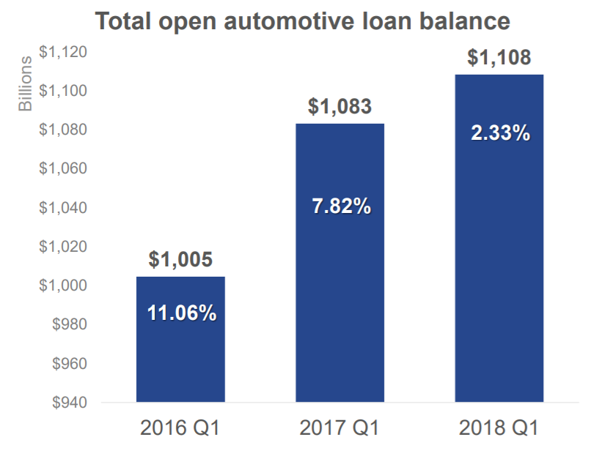
State of Auto Finance Lending – Q1 2018
Loan balances reach another record high-yet experience slowing growth
30 day delinquency rates are beginning to improve
Percentage of subprime loans falls below 19% of loan balances
Longer term loans continue to dominate the market (60-66 months)
85% of consumers with new vehicles vs. 54% of consumers with used vehicles are financing
Leasing remains very prime while more consumers shift into the loan space
Record highs for average new and used loan amounts
State of the Automotive Finance Market Experian
PAYNEARME UPDATE
5
Notes:
So what does this data mean for auto lenders?
Though the growth of car sales is slowing, the loan balances are increasing with longer loan terms.
So this means more payments need to be made for longer durations of time, and we need to find a way to improve that payment experience and make it easier for consumers to make on time repeat payments.

Slide 6
Customers are Asking
“Why is the auto loan process so complex, and why does it take so long to reach a credit decision?” Customers want simpler loan applications—and faster decisions about those loans and faster and easier ways to pay.
Source: Auto Finance Industry Trends that will disrupt lending in 2019
PAYNEARME UPDATE
6

Slide 7
Top 5 Trends for Auto Lenders
1.
Cloud-based lending platforms
2.
Use predictive analytics
3.
Provide a richer user experience with expanded payment options
4.
Cater to the millennial buyer
5.
Move towards
digital presentment
PAYNEARME UPDATE
7

Slide 8
Trend 1. Cloud-Based Lending Platforms
“Fully exploit the proven technical capabilities of the cloud to enable a better lending experience.”
Source: Auto Finance Industry Trends that will disrupt lending in 2019 – Auto Finance News
PAYNEARME UPDATE
8

Slide 9
Trend 1. Cloud-Based Lending Platforms
Lenders benefit in a variety of ways
Faster implementation
Continuous delivery of new functionality
Frequent software updates
Cost savings when compared to legacy on-premise systems
PAYNEARME UPDATE
9

Slide 10
Trend 1. Cloud-Based Lending Platforms
The cloud simplifies the lending and payment acceptance process
Allows loans to be initiated anywhere anytime
Digitizes loan documents and digitize presentment information
Replaces manual processes with automation and business rules
Enables payment acceptance more readily with a simple intuitive user experience
Allows consumers to pay from anywhere, anytime; and results in more on-time payments
PAYNEARME UPDATE
10
Notes:
Christian: So John, is there a vendor out there who can provide all this functionality in a single platform?
John: PayNearMe handles the payment piece – we have partners that enable the loan origination piece. (elaborate)

Slide 11
Trend 2. Use Predictive Analytics
“Predictive Analytics help lenders modify and fine-tune lending policies and practices—and respond to market changes quickly when needed. Lenders can access data to perform important business functions ”
- Auto Finance Industry Trends that will disrupt lending in 2019 – Auto Finance News
PAYNEARME UPDATE
11
Notes:
BIG DATA DRIVEN ANALYTICS IN THE PAYMENTS INDUSTRY..
Much like the other areas of finance, the payments industry can benefit tremendously from adopting the latest techniques in data storage and analysis.
Christian – So John – what are the important ways in which payments industry can leverage the diverse and extensive data assets they possess to perform important business functions
John to talk through next slide

Slide 12
Trend 2. Use Predictive Analytics to help with
Integrating all the complex & disparate functions of Payments Platforms
Detecting Payments Fraud
Risk Scoring of Payments in Realtime & Batch
Detecting Payments Money Laundering (AML)
PAYNEARME UPDATE
12
Notes:
Analytics help lenders modify and fine-tune lending policies and practices—and respond to market changes quickly when needed.
and automates roll out of credit scoring and regulatory upgrades
Integrating all the complex & disparate functions of Payments Platforms Most payment providers offer a variety of services. E.g. credit cards, debit cards and corporate payments. Integrating different kinds of payment types – credit cards, debit cards, Check, Wire Transfers etc into one centralized payment platform. This helps with internal efficiencies (e.g collapsing redundant functions such as fraud, risk scoring, reconciliation, reporting into one platform) but also with external services offered to merchants (e.g. forecasting, analytics etc).
Detect Payments Fraud Big Data is dramatically changing that approach with advanced analytic solutions that are powerful and fast enough to detect fraud in real time but also build models based on historical data (and deep learning) to proactively identify risks.
Risk Scoring of Payments in Realtime & Batch Payment Providers assess the risk score of transactions in realtime depending upon various attributes (e.g. Consumer’s country of origin, IP Address etc). Big Data enables these attributes to become granular by helping support advanced statistical techniques to incorporate behavioral (e.g. transaction is out of normal behavior for a consumers buying patterns), temporal and spatial techniques.
Detect Payments Money Laundering (AML) A range of Big Data techniques are being deployed to detect money laundering disguised as legitimate payments.

Slide 13
Trend 2. Use Predictive Analytics
Apply analytics to the portfolio to gain a better understanding of profit and loss
Lenders should use analytics regularly
Identify the most profitable deal sources
Determine borrower characteristics that indicate potential delinquency risk
Monitor approval, book-to-look, and capture ratios by week, month, or years
Identify bottlenecks in loan processes and eliminate them
PAYNEARME UPDATE
13
Notes:
Appling analytics to the portfolio can gain lenders additional insights of where and why you are profitable and where and why losses occur.
Christian: Predictive analytics can help view payment data to see who you want to approve.
So John, can you highlight how payment data can be leveraged?
John: Predicative analytics - data is your most valuable asset. Discuss in general what we can glean from the wealth of data we collect.

Slide 14
Trend 3. Provide a Richer User Experience
With Expanded Payment Options
A recent article published in The Financial Brand reported 61% of banks listed “removing friction from the process and providing more payment options in order to capture more Millennials” as a priority for 2018 and beyond.
- Top Banking Trends and Predictions Outlook – The Financial Brand
PAYNEARME UPDATE
14

Slide 15
Trend 3. Provide a Richer User Experience
With Expanded Payment Options
Reduce friction and improve the user experience
Make the loan application and monthly payments processes faster, easier and safer with online lending platforms and fintech systems
Lending-as-a-Service (LaaS) platforms provide a fully managed, turnkey approach with natural language chat
An omni-channel delivery system with multiple payment options allows every customer to choose how they want to access their accounts.
One of the fastest growing trends is the mobile-only payment experience, supported by a live customer service representative when the customer has a question
PAYNEARME UPDATE
15
Notes:
LaaS automates processes (and improve credit decisions, provides alternative credit scoring options, and automates roll out of credit scoring and regulatory upgrades)
Turnkey approaches with machine learning incorporate natural language chat and chatbots
Christian: John, what trends are you seeing in lending platform UI/UX design that provide a richer user experience?
John – discuss
the importance of omni-channel delivery and mobile-first design
Providing a mobile-only payment experience reduces friction
Redesign and enhance the digital experience for your customers to provide a simple frictionless 3 step flow
Talk about user engagement
Talk about the expanded payment options - discuss the standard options then discuss apple pay, android, RTP, Venmo, etc.

Slide 16
Polling Question 1
What % of your consumers use mobile devices to make payments?
<10%
10-50%
> 50%
PAYNEARME UPDATE
16

Slide 17
Trend 4. Cater to the Millennial Buyer
Millennials don’t purchase new vehicles. True or False?
This demographic is maturing and is now poised to be a driving force in auto lending.
– Millennial Myth Busted - Young Consumers Really Do Like New Vehicles - Experian
PAYNEARME UPDATE
17

Slide 18
Trend 4. Cater to the Millennial Buyer
Millennials account for all new vehicle sales growth* in the North American auto industry during the first quarter of 2018.
Millennial vehicle market share jumped from 27.9 percent in Q1 2017 to 29.7 percent in Q1 2018
Generation X was flat at 27.2 percent, while the “mature market” and baby boomers each lost share.
The “mature market” share fell from 9.6 percent to 9 percent
Baby boomers’ share fell from 35.2 percent to 34.1 percent
Millennials represent the largest consumer demographic. They’re younger with more disposable income
* From Real world Vehicle registration data
PAYNEARME UPDATE
18
Notes:
In addition to auto loans, more millennials are taking on personal loans to fund things like moves and weddings and to build their credit scores

Slide 19
Trend 4. Cater to the Millennial Buyer
Don’t ignore the millennial population
Analyze local markets and connect with prospective millennial car buyers
Lending platforms should be mobile-first to offer millennials a faster and simpler user experience in getting loans and making payments
Lending platforms should integrate features that appeal to millennials – like payment reminders, chatbots and mobile wallets
PAYNEARME UPDATE
19
Notes:
This slide addresses what lenders, dealers and retailers can learn from the data. What are you doing to serve this market? 90% of this demographic has mobile phones. How can we leverage that?
Americans spend 20% of their waking hours on a mobile device. However, mobile penetration in the auto-lending industry is only 5%.
Christian: John, can you expand more on specific features payment platforms are planning to cater to this demographic?
John – to discuss
The user experience, with expanded payment options;
Talk about the standard options then discuss apple wallet, google pay, RTP, Venmo, etc.
3. Address features like natural language chat and Alexa affect (and chatbots) and the role this plays in consumer lending

Slide 20
Polling Question 2
How important is it for your organization to provide a best-in-class mobile-first user experience to your consumers?
Not Important
Somewhat Important
Neutral
Important
Very Important
PAYNEARME UPDATE
20

Slide 21
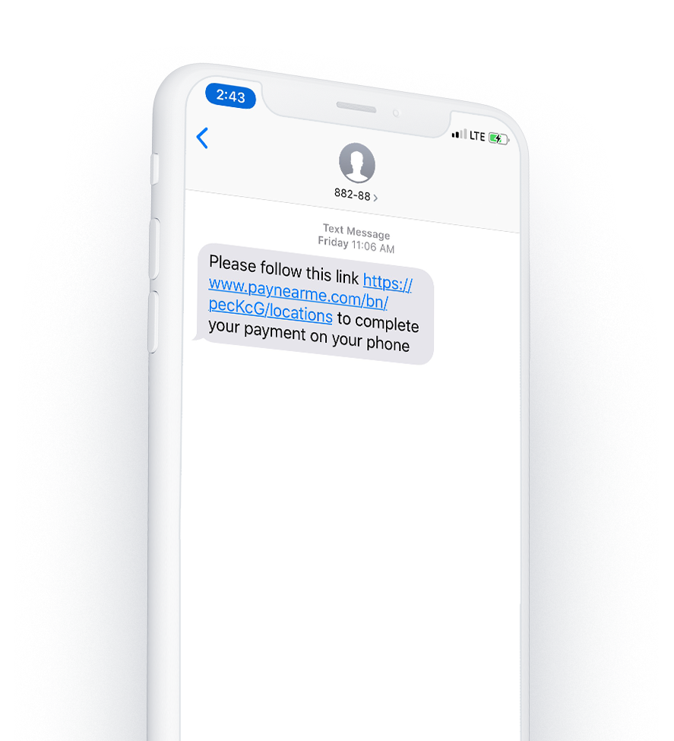
Trend 5. Move Towards Digital Presentment
We’re entering into a new phase of customer communication. Personalization, interactivity and ‘anywhere access’ are king.
Customers also expect personal and interactive messages from you. As customers use electronic statements more, they also expect more features. Now it’s time to add one-to-one marketing messages and videos.
PAYNEARME UPDATE
21
Notes:
Now we tell our phones “Ok Google, get me directions to the nearest golf course.” Then Google will tell us “you will arrive in 10 minutes but the course doesn’t open for another 30 minutes.”
Christian: So John, can you give us examples of what consumers will be receiving as text messages from their payment providers?
John – go to next slide

Slide 22
Trend 5. Move Towards Digital Presentment
Raise loan servicing satisfaction with one-to-one messaging in loan statements.
Show payment balances and send reminders digitally
Integrate with mobile wallets
Important to have both digital invoices and physical mail
Imagine the possible messages you could send to a customer’s phone:
“You’re 30 days delinquent, click here for a personalized payment plan”
“You will pay off your car loan next month, click here to see next year’s models”
PAYNEARME UPDATE
22
Notes:
John to present this slide
Presentment is all about moving away from paper.
Doing presentment on mobile phones can accelerate more on-time payments.
This will allow us to present the amount due on mobile - integrated with reminders
Christian: John, today we have multiple solutions to send messages (Solutions By text) and for providing a mobile wallet solution (like Walletron). How can a single solution that brings all this together benefit lenders?

Slide 23
Polling Question 3
How important is it for you to provide payment reminders to your consumers to overcome late payments?
Not Important
Somewhat Important
Neutral
Important
Very Important
PAYNEARME UPDATE
23

Slide 24
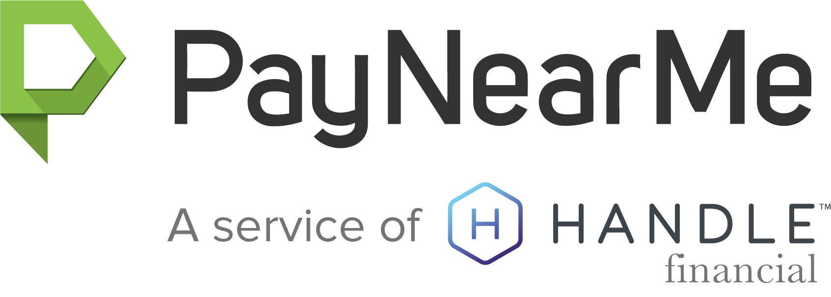
Key Takeaways
So what do these trends mean for Auto Lenders?
90% of the US population has access to a mobile phone and 73% of them have smartphones
Make your product mobile-friendly with digital presentment including reminders on payment amounts and mobile wallet integration
Make it simpler for your customers to apply and pay for their loans by removing friction in the loan application and loan repayment process
Incorporate technologies such as biometric security, natural language searches, and chatbots.
PAYNEARME UPDATE
24
Notes:
From a PWC 2017 report titled FinTech’s growing experience on financial services https://www.pwc.com/jg/en/publications/pwc-global-fintech-report-17.3.17-final.pdf
Companies are putting their spotlight on emergent technologies. Innovators excel at providing products that make existing user experiences better. These developments include technologies such as enhanced biometric security, natural language searches, and chatbots. As they adopt these solutions, they are not only focusing on enhancing client service but also on improving efficiency, reducing costs, increasing security, and making processes more agile.

Slide 25
About PayNearMe
PAYNEARME UPDATE
25

Slide 26
Who We Are
The single platform to meet all your payments needs.
Enables businesses and government agencies to accept cash, debit, credit, and ACH payments
Provides underserved customers with a mobile or printed cash payment option at 27,000+ locations nationwide
Delivers a complete, mobile-first payment experience with transparent fees and superior service
PAYNEARME UPDATE
26

Slide 27
Trusted Enterprise with a Secure Platform
Third-party accreditation from the International Standards Organization and PCI Security Standards Council
Compliant with Regulations:
Bank Secrecy Act
USA PATRIOT Act
OFAC
CFPB guidelines for consumer protection against abuse
Anti-money laundering controls, including transaction monitoring and limits
PAYNEARME UPDATE
27

Slide 28
PayNearMe’s Evolution
2009
2018
Now, we process cash, debit and ACH
Trusted by customers to process cash payments
We integrate with Apple Wallet and Google Wallet
Our optimized mobile user experience includes text messaging and payment reminders
Money transmitter licenses in all U.S. states where required
PAYNEARME UPDATE
28

Slide 29
Thousands of Businesses Rely on PayNearMe
Lending
Collections
Transportation
Property Management
Utilities
eCommerce
Non-Profit
Government
PAYNEARME UPDATE
29

Slide 30
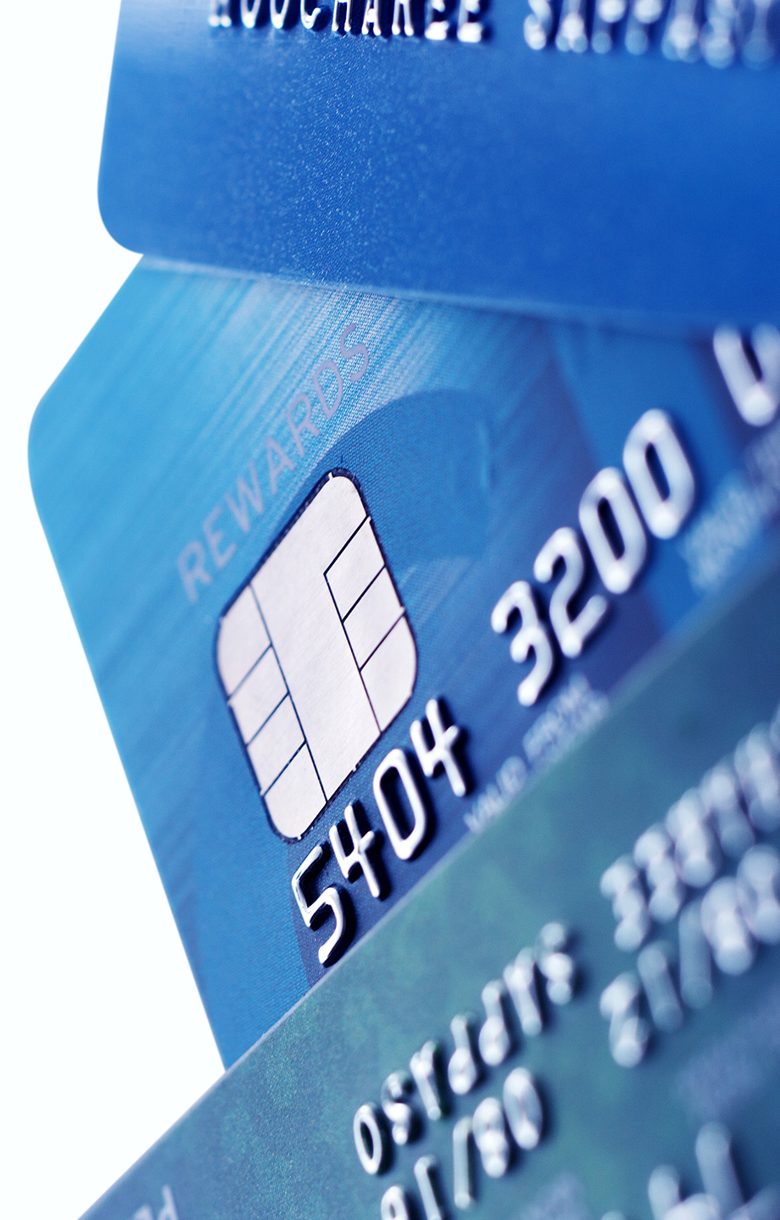
The PayNearMe Value Proposition
Mobile-First
Simple, intuitive, frictionless user experience for accepting payments
Fast and convenient for customers to pay their bills
Complete Solution
Single partnership for processing all payment types; cash, card, ACH
Payment reminders and mobile wallet integration
Superior Service
Best-in-class merchant support
Faster implementation and setup time
Transparent Fees
No hidden or confusing fees
Clear and understandable billing
PAYNEARME UPDATE
30
Notes:
Value Propositions
Trusted- Single partnership for processing all payment types
Reliable- Enterprise-level uptime- Best-in-class security certifications
Transparent- No hidden / confusing fees- Understand what's on your bill
Simple- Intuitive user experiences remove friction from accepting payments- Easy integration options
Enterprise level uptime
Best-in-class security certifications

Slide 31
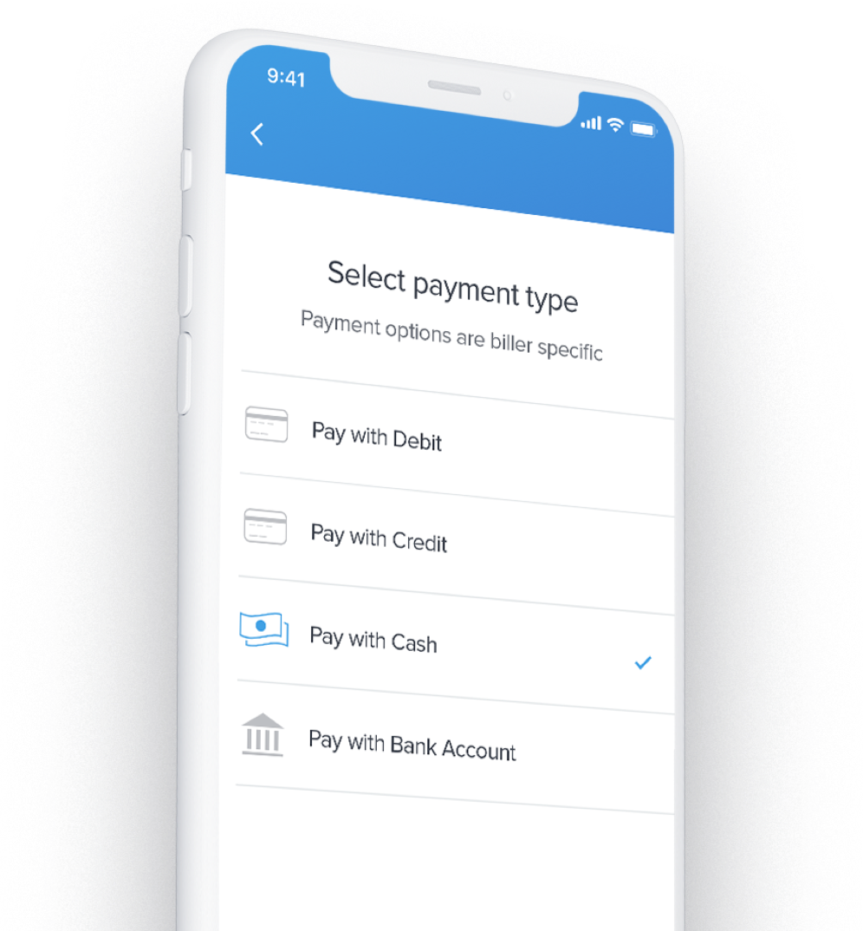
PayNearMe Feature Summary
Mobile friendly user experience
Single solution for payments, reminders and mobile wallet
Simple and convenient 3-step flow
Multiple payment options – debit card, credit card, ACH and cash in store – via mobile or desktop
Configurable SMS, email and push notifications
Mobile wallet integration with
PAYNEARME UPDATE
31
Notes:
Features
- debit processing
ACH processing- national cash-acceptance network
unified settlement / reconciliation process- PCI certified- ISO 27001 certified
SSAE-18 audited
SOC II Level 2 compliant
get guaranteed receivables with cash payments
one price plan per tender type- lower consumer fees than competitors
mobile first- integrated with iOS/Android for saving payment details
configurable SMS and push notifications to consumers for reminders
- standalone and integrated technology options

Slide 32
Polling Question 4
Are you ready to discuss how a complete mobile-first payment solution can transform your business?
Immediately
In 2 weeks
In 6 months
PAYNEARME UPDATE
32

Slide 33
QUESTIONS? CONTACT US TODAY!
Christian Solomine | VP Sales christian@paynearme.com 303.522.4430

